Slide 1
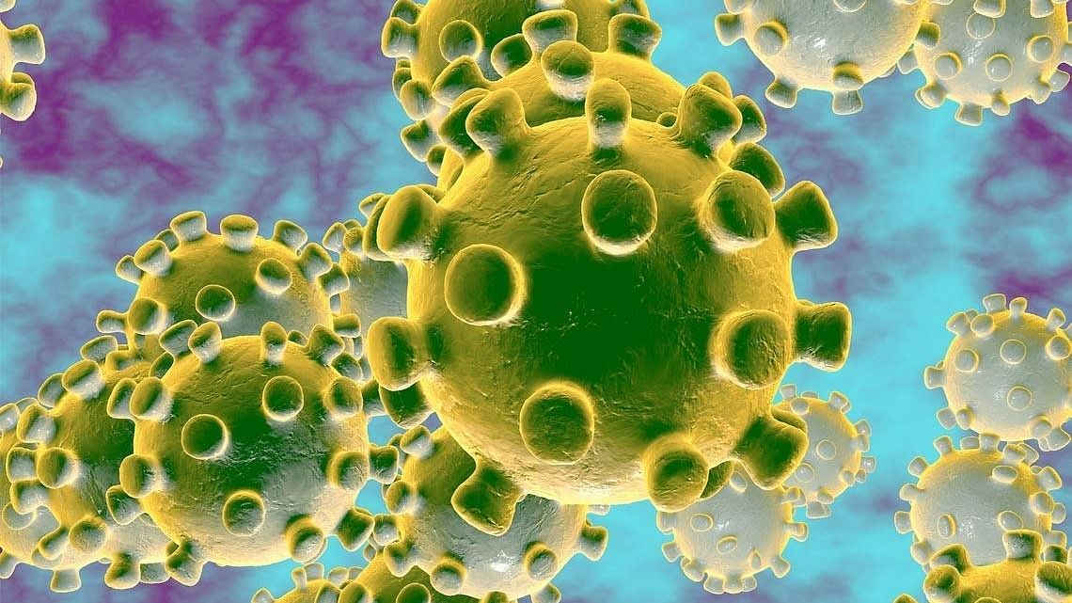
Minor Project- Visualization
COVID-19 Data of Maharashtra
Submitted by: RASHMI
H12096

Slide 2

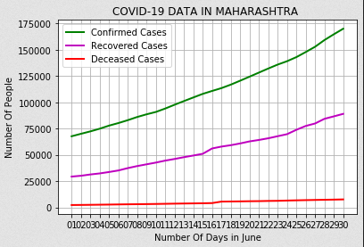
The result shows that Maharashtra facing a big crisis which lead it to the top state in nation for its total number of cases. In the last week of June, the cases are increasing rapidly and reached up to 2 lacks which is a serious concern.
People are recovering but, not that high as number of infected people.
Fatality may be seem as constant but still its not good. The mortality rate of the state is around 3-4%
The percentage of fatalities has remained the same as the number of cases increasing.
Possible reasons for being on top:
Administrative reasons- opening of offices, markets and etc. by Delhi Government
May be more screening in Maharashtra could be the reason
People are sensitized and well aware about precautions.
Mumbai and Pune are also a hotspot of foreign travelers and immigration

